Slide 1
Northern Powergrid
Competition in Connections Seminar
17 November 2022
Leeds Marriott Hotel

Slide 2
Welcome and Overview
Phil Jagger
System Design Manager

Slide 3
Competition in Connections Update
Clare Roberts
Connections Input Services Operations Manager

Slide 4
Performance

Slide 5
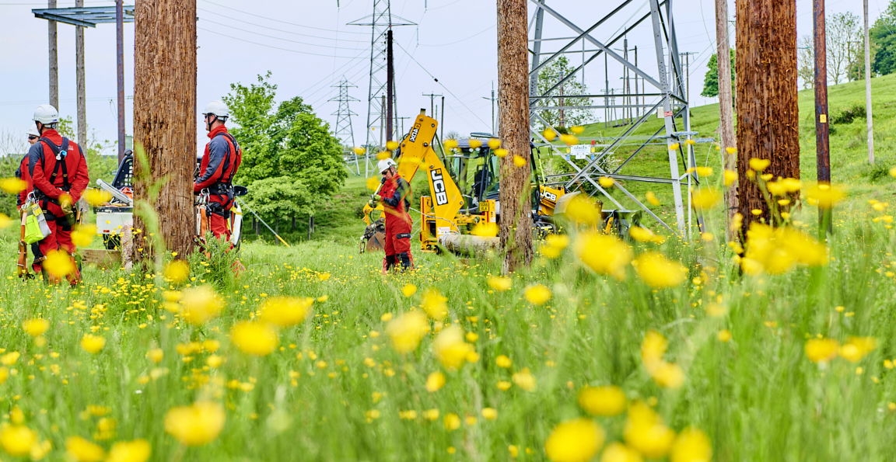
Application form for self-determined schemes - needs to be completed in full and correctly
ICPs can register to receive email updates
Website improvements - Check it regularly for updates and tell us what else you need
What’s changed…

Slide 6
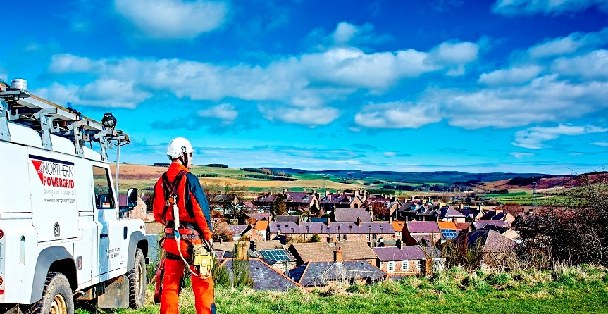
On the horizon…

Slide 7
Access and Forward-Looking Charges Significant Code Review (the ‘Access SCR’)
Ofgem published the Authority’s final policy decision in May 2022, which:
  Changes the ‘connection boundary’ i.e. how much a connectee pays upfront
  Introduces defined access rights for a connection subject to Curtailment
  Amends the description of a Speculative Development, to ensure a consistent application
  The latter includes the need to consider a methodology for connections with a phased capacity
We have been directed to implement the policy effective from 1 April 2023
Legal text that will explicitly set out our new obligations is being implemented by Distribution Connection and Use of System Agreement (DCUSA) change proposals (DCPs) 404-407*
An Authority decision (at least in principle) is expected this year on all four
We will provide more clarity following the Authority’s decision
* https://www.dcusa.co.uk/change-overview/change-proposal-register

Slide 8
Who pays for what?
In simple terms, the connection charge will be cheaper for the connectee
Therefore, more cost will be socialised through distribution use of system (DUoS) charges
Subject to ‘exceptions’ and a High-Cost Project Threshold (the ‘High Cost Cap’ or HCC):
  Removes reinforcement costs for a demand connection*
  Applies apportioned reinforcement costs at the voltage of connection only for a Generation Connection*
HCC for a generation connection remains £200/kW, demand connection set at £1,720/kVA
  Costs above the HCC will include all costs for reinforcement at the voltage of connection and one above
Reinforcement costs for a speculative development will continue to be charged in full
A connection with a phased capacity should not change upfront costs (caters for the total capacity)
* For both demand and generation, the existing arrangements include apportioned reinforcement costs at voltage
levels above the point of connection too

Slide 9
What are my ‘access rights’?
The Access SCR will introduce defined curtailable access (a ‘Curtailable Connection’)
Curtailment excludes:
  Interruptions caused by a fault on or damage to the Distribution System; and/or
  Curtailment as a result of constraints on the transmission network
The changes will not impact existing users’ access rights (a new application will be needed)
New obligations will include:
  Common calculation, and measurement of curtailment relative to a curtailment limit;
  Measures to avoiding exceeding the limit (e.g. procuring flexibility services);
  Paying the customer based on a defined and ‘markedly high’ price if exceedance of the limit cannot be avoided;
  Reporting requirements to the customer; and
  End dates for converting to a non-curtailable connection
  Does not apply to a ‘small user’*
* means (a) domestic and non-domestic customers that are billed on an aggregated and non-site-specific basis or who
are metered directly using whole current meters; or (b) an Unmetered Supply (as directed by Ofgem)

Slide 10


What you told
us…
What we’ve been
working on…
Consistent ways of working across all regions
Looking at how we can do this in Q1 2023
Trial for LV schemes allowing IDNOs to self-fill the BCA
Improvements to our webpages and document library
Thinking about how we can keep you updated
Internal briefs issued to all Programme Managers
Consistency
Senior management level interaction
BCA autofill template
Better information and clarity
Updates to significant policies/ databases
Engineer assignment in Connections delivery

Slide 11
Changes to Standard Design Rules
Richard Proctor
Design Team Manager

Slide 12
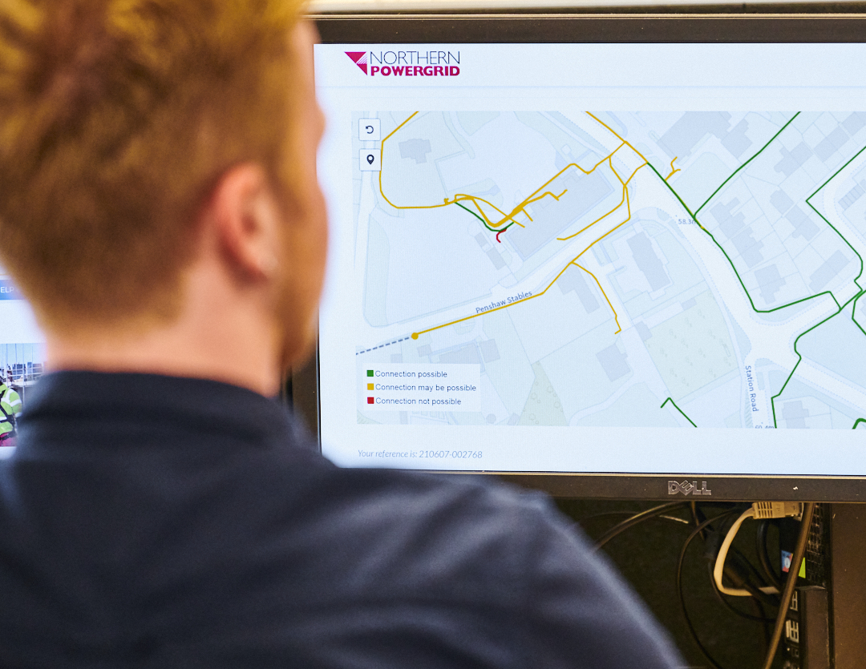
What are Standard Design Rules (SDRs)?
  The SDRs are a set of rules that enable a less experienced designer to carry out an assessment to check the suitability of a connection to the LV network
  These are typically used internally by NPg to assess:
    One 1ph domestic or non-domestic service connection
    Up to four domestic 1ph connections involving a
    mains extension
    One 3ph domestic or non-domestic whole current connection not requiring an extension to the LV network
  However the scope also includes:
    Up to twenty 1ph domestic non-electrically heated service connections.
    One 3ph domestic or non-domestic whole current connection requiring an extension to the LV network

Slide 13
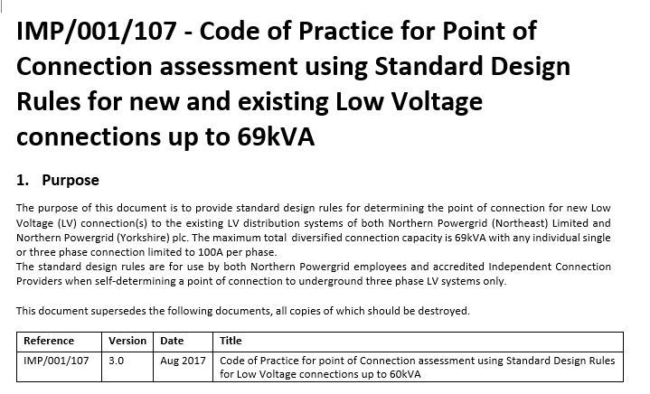

Changes to the SDRs
The title of the document has changed
  Due to the increase LCT requests, the new rules reflect the increase in applications for 100A connections
  All previous references to 80A have been changed 100A

Slide 14
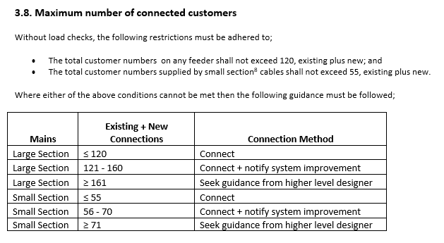
Changes to the SDR
Revision of the maximum number of customers on an LV feeder

Slide 15
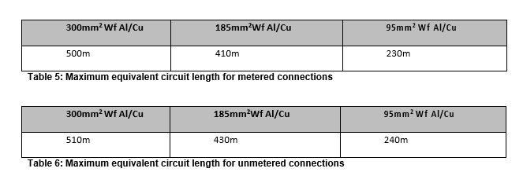

Changes to the SDR
Reduction to the maximum size of transformer
  The previous maximum size was 315kVA, this is now 200kVA
  All previous references of 315kVA have been changed to 200kVA
Revision of maximum cable lengths for existing systems
Revision of service cable lengths in line with LV policy

Slide 16
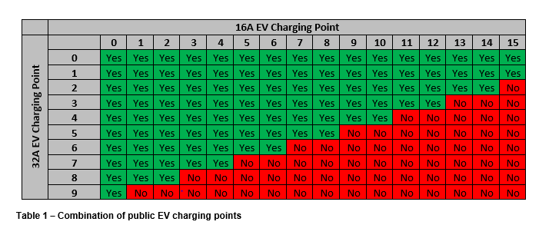
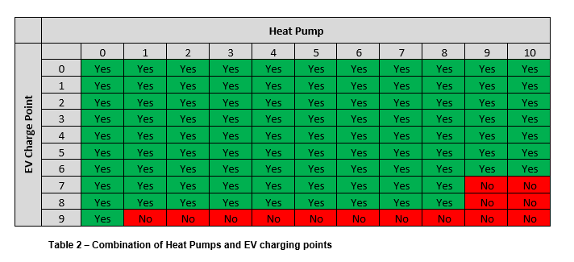
Changes to the SDR
Expanded tables for:
Public EV charge points
Domestic EV charge points up to 32A
Heat pumps up to 16A

Slide 17
Land Rights
Wayleaves Appreciation
Josh Bradley
Senior Wayleaves Officer – New Connections
17

Slide 18

Wayleaves Team
  Wayleaves Team Manager – Nick Oliver
  Senior Wayleaves Officer New Connections – Josh Bradley
  New Connections – Fifteen Wayleaves Surveyors and five Business Support Advisors covering both our licence areas
  Dedicated solicitors from external law firms dealing specifically with our legal work
  Dealing with customer funded diversions,
  other workstreams that look after EHV and
  non-customer funded connections
  Contact 0191 229 4604 or email wayleavesinstructions@northernpowergrid.com quoting your ENQ number

Slide 19
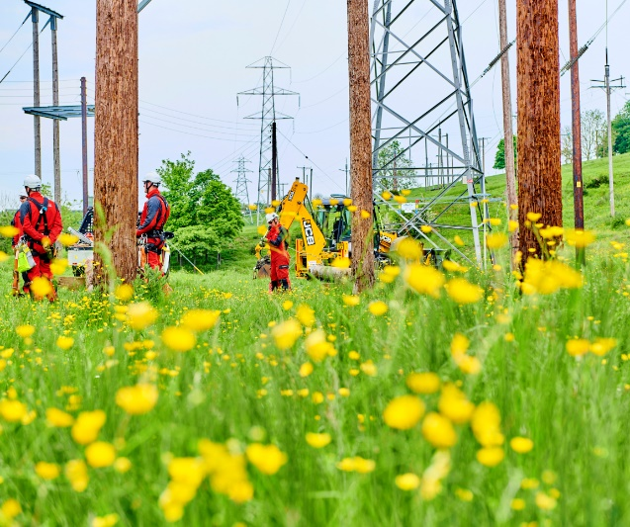
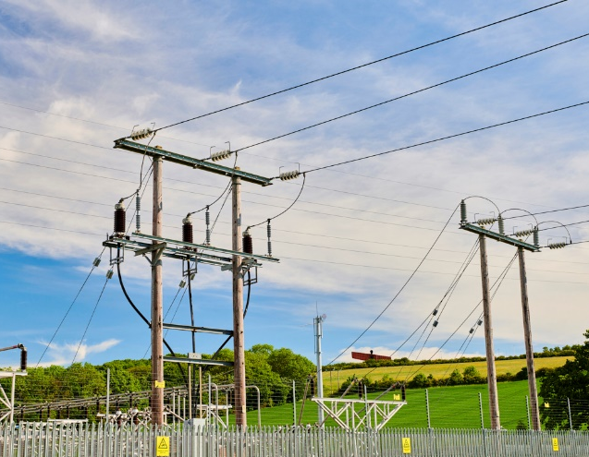

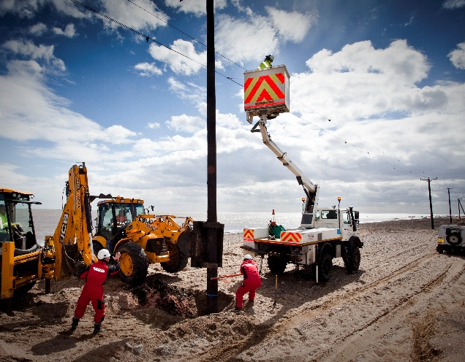
What are Land Rights and why are they needed?
The term ‘Land Rights’ is used as a collective term to cover the acquisition of property rights, such as Freehold and Leasehold interests, Easements or Wayleaves, as well as consultations and statutory consents that may
be required before any connection equipment
can be installed
The DNO (Northern Powergrid) cannot install or utilise equipment required for a connection to our electricity distribution network without the consent of the landowners and occupiers of any land affected by the work. This is a requirement of the Electricity Act 1989

Slide 20
Types of Agreements – O/H lines and U/G cables
Easements
  Documents executed as Deeds (Deed of Grant of Easement)
  A deed is a permanent right (may be for fixed term)
  Can take 3-4 months to complete and needs solicitors to be involved
  Typically completed for the development site but occasionally third party easements may be required
Wayleaves
  A wayleave is a personal licence (i.e. it doesn’t ‘run’ with the land)
  Wayleaves can be terminated
  Consent required from owner and occupier
  Used to cover apparatus through third party land
  Can be protracted as the third party has no interest in the scheme
  Difficult to provide timescales as third party consents are outside of our control, can be days or months

Slide 21
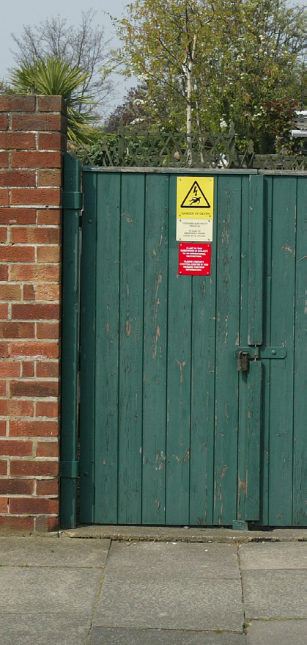
Types of Agreements – Substations
Lease
  Legal document completed by solicitors for substation sites.
  Normal term of the Lease is 60 years+
  Typically completed for industrial/commercial developments
  Lease of rights for integral parts of buildings
  Would contain rights for access and cables
Freehold Transfer
  Legal document completed by solicitors for substation sites.
  Permanent interest in the land - owned by NPg
  Typically completed for housing developments
  Would contain rights for access and cables

Slide 22
Other Statutory Consents and Permissions
Planning
O/H Lines
  Development consent is required from LPA for minor alterations covered under The Overhead Lines (Exemption) Regulations 2009.
  For more significant changes to the overhead network, full planning consent for overhead lines is required under Section 37 of the Electricity Act 1989 from BEIS – this can only be done by the DNO
Substations
  If a new substation housing is required and is being supplied by the customer, it is the responsibility of the customer to obtain planning permission
  If the housing is supplied by NPg and it has an internal capacity ≤ 29m³, this can by done by prior notification under Class B (a) of Part 15 Schedule 2 of the Town and Country Planning (General Permitted Development) Order 2015
  A proof of planning consent obtained will need to be provided before any legals can be completed

Slide 23

Other Statutory Consents and Permissions
Environmental
  Consents and considerations are required under our obligations of Schedule 9 of the Electricity Act 1989, our duty as to preservation of amenity
  Includes (although not exclusively):
    Natural England
    Historic England
    Environment Agency
    Archaeological consultations
    TPO’s
    Protected species
    Common land and village greens

Slide 24

Other Statutory Consents and Permissions
Working in ‘Adopted Highways’
  These are areas which are defined as ‘streets’
  under the New Roads and Street Works Act 1991 and usually include roads, verges, pavements and are maintained by the local authority
  The ICP/IDNO will require a suitable licence to
  work in these areas
  On some developments the maintenance of
  the new roads and pavements is to become
  the responsibility of the local authority under
  Section 38 of the Highways Act 1980
  If the apparatus installed in these areas is to
  be the responsibility of NPg we will require
  S38 confirmation from the local authority that
  they will adopt the new roads or it will need to be
  suitably secured (Wayleave or Easement)
  prior to connection

Slide 25

Obtaining Land Rights - ICPs
  When an ICP carries out works on third party land they must have initially obtained their own permission from the land owners and occupiers to carry out the construction/installation works of the connection equipment
  This ICP consent should not only include the ICPs right of access and installation of the equipment but also their liabilities for reinstatement and damage
  Upon completion of the installation and prior to connection, standard agreements securing the land rights will need to be completed in the name of NPg
  This will set out the rights of access, maintain and replace the equipment from the date it is adopted from the ICP. The scheme will then be cleared to the delivery engineer for completion

Slide 26
Obtaining Land Rights - IDNOs
POC acceptance is allocated to a
Wayleaves Officer
The design is approved and a S38 plan
sent to the allocated Wayleave Officer - they will determine whether NPg require any property rights
If applicable, the third-party landowners and legal representative’s details will be required before NPg’s solicitors can be instructed
On completion of the legal work, the scheme is cleared to the delivery engineer for connection

Slide 27

Incorporated Rights - IDNOs
  This essentially allows the IDNO to negotiate on a ‘subject to contract’ basis with the landowner to give NPg suitable rights and security
  Upon design approval the Wayleave Officer will need to be issued with the proposed legal drawing and confirm it is acceptable
  The IDNO solicitor will agree the required rights in line with the Incorporated Rights Agreement
  Upon provision of the completed document which must be sent to the Wayleave Officer, the scheme will then be cleared to the delivery engineer for connection

Slide 28

Reference Materials
Model Agreements:
  Lease, Wayleaves and Transfer
  No amendments or alterations
  can be made without the approval
  of NPg’s Wayleaves Manager
Wayleave Payments
Colouring of Plans
Incorporated Rights Agreements
www.northernpowergrid.com/sites/default/files/2022-05/3446.pdf

Slide 29
Thankyou. Any questions?
Wayleaves - New Connections
0191 229 4604
wayleavesinstructions@northernpowergrid.com

Slide 30

Break
11.20-11.30

Slide 31

Northern Powergrid
Competition in Connections Seminar
17 November 2022
Self-Determination LV PoC Process
Presented by Damian Ireland
Operations Director
J Geraghty Ltd

Slide 32
Who we are
J Geraghty Ltd was founded on 2014 & moved into the MU sector in 2017 and is now a leading Multi Utility Contractor in the Yorkshire & North East, working with leading commercial organisations & domestic clients to manage projects from concept to completion for the connections of Water, Gas & Electric services
Full accreditation by Lloyds Register under the National Electricity Registrations Scheme (NERS) to undertake the following ICP scopes;
LV cable networks to domestic properties
LV cable networks to industrial/commercial properties
LV jointing
HV jointing: 20kV
HV Cable Networks: 20kV
Sub-station Installation: 20kV
Self Determination of Point of Connection (POC): LV
Working with IDNO’s – ESP, Last Mile, & Fulcrum

Slide 33
Northern Powergrid Self-Determination Application Process (ABC)
Submit Self-Determined PoC Notice Form ‘Part A’ to CinC
Part A submission to enable NpG Engineers to carry out the relevant checks in relation to interactivity, the Electricity Connection Charges Regulations, and requirement for any reinforcement works.
Rejected application – apply for PoC
Delays as questions raised on meter point location, service disconnections, entry point, meter point, internal wall types, route, land Rights, loadings, interaction with services, etc

Slide 34
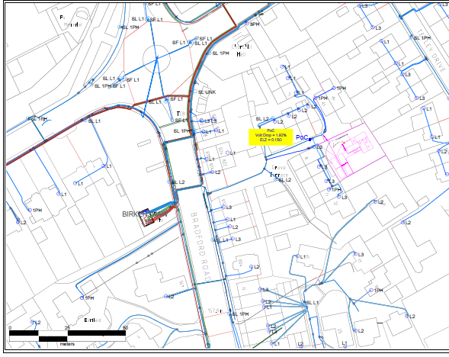
Self-Determine PoC – Part A
Housing Development – Grove Terrace
Issue Self-Determine PoC Part A
Issue PoC Plan

Slide 35
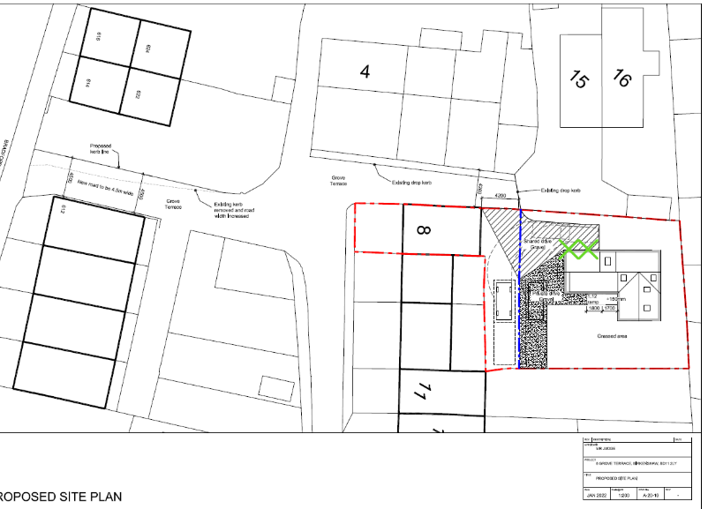
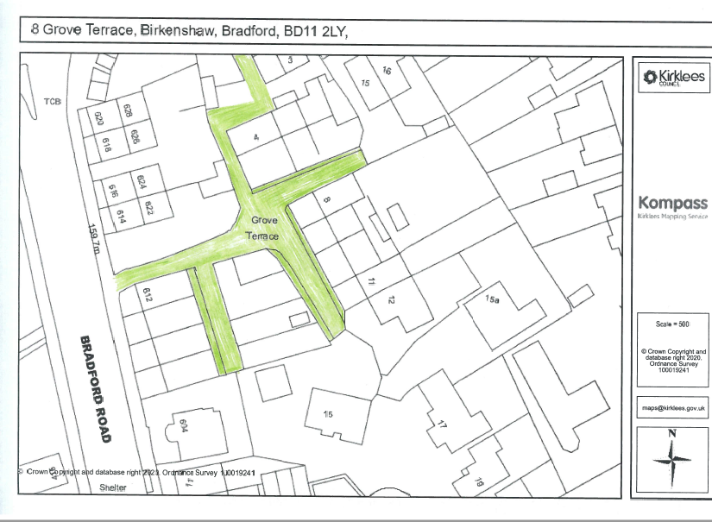
Additional Info
Assist with the process we issued additional documentation:-
Site Location Plan – Why? Guide for cable route from PoC to the site, HV/LV Diversions
Red Line Boundary – Why? Guide on Wayleaves/Land Rights
Part A – Issued 06/10
Approval – Due 14/11

Slide 36
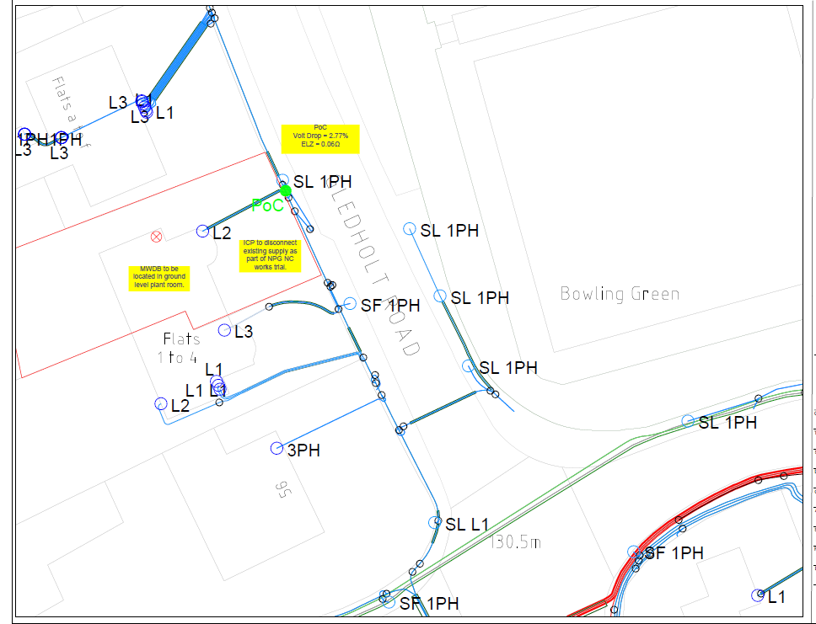
Self-Determine PoC – Part A
Housing Development – Gledholt Road
Issue Self-Determine PoC Part A
Issue PoC Plan

Slide 37
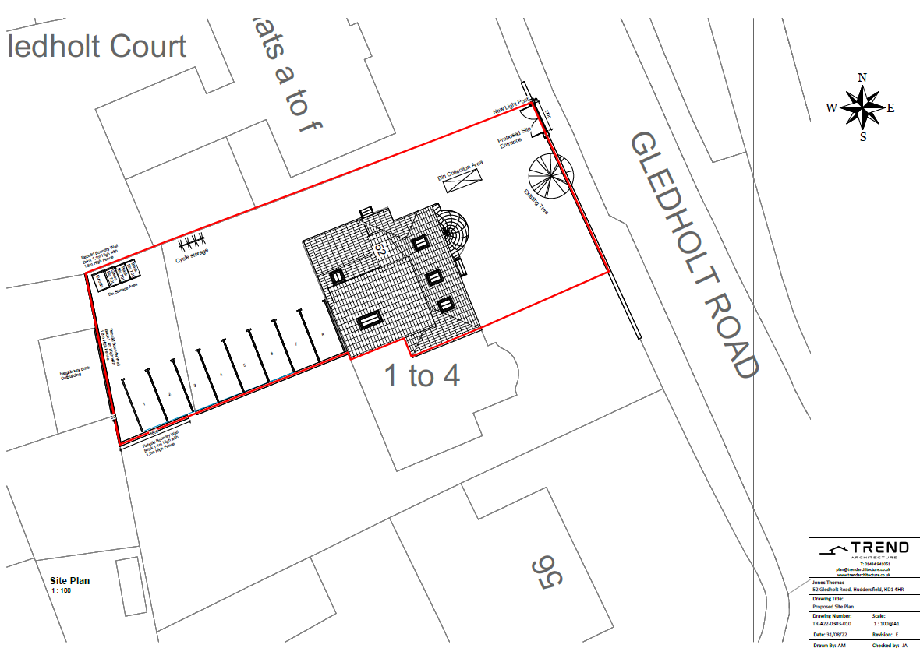
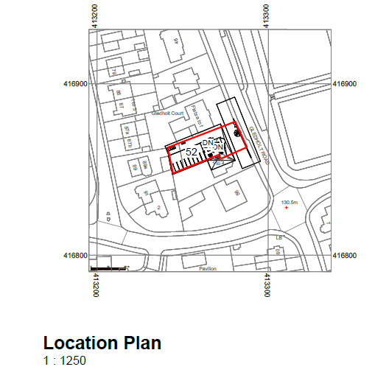
Additional Info
Assist with the process we issued additional documentation
Site Location Plan – Why? Guide for cable route from PoC to the site, HV/LV Diversions
Red Line Boundary – Why? Guide on Wayleaves/Land Rights
Part A – Issued 06/10
Approval – 04/11

Slide 38
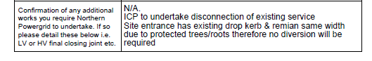
Northern Powergrid – Part A
The designer stated in her confirmation email that “At present there is an existing dropped kerb. If this is to remain then no diversion will be required, however if the ICP is forming a new site entrance as per their plan, then 2 x non contestable straight joints will be required. Also, there is a street light next to the site entrance which they appear to have shown in a different position. They will need to contact the local authority regarding this, it is not something we would quote for.”
Part B comments

Slide 39
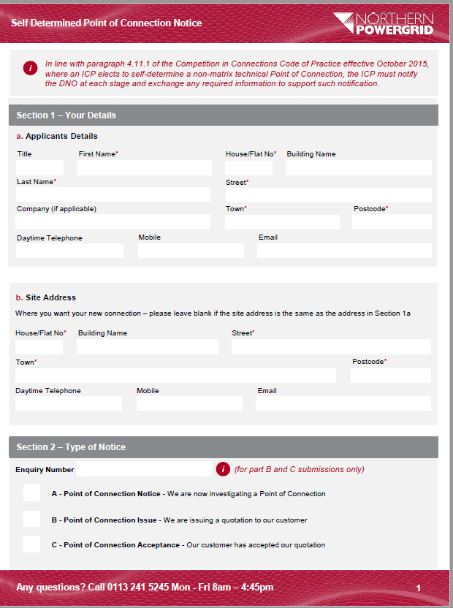
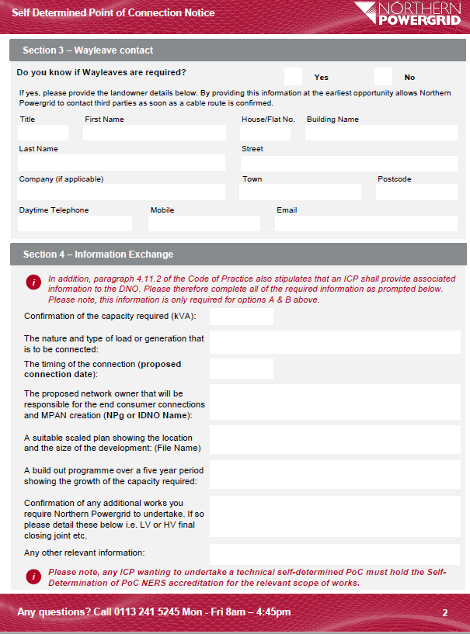
Self Determined PoC Notice V4
Section 1 – Details & Site Address
Section 2 – Type of Notice A-B-C
Section 3 – Wayleave – provide details if required
Section 4 – Capacity, Location Plan, Network Owner, Connection Date, Any Npg works

Slide 40
Pros & Cons
Advantages
Identify any Wayleaves/Land Rights/3rd Party involvement
Identify any potential NC Works – Disconnections & Diversions
Provide guidance on proposed route from PoC to Development
Enables the NPg Design Engineer to have some knowledge of the scheme from PoC to Site

Slide 41
Thank you
Any questions?

Slide 42
Quality Assurance Inspections
Assessors
Michael Proctor
Gary Schofield
Michael Proctor
17th November 2022

Slide 43
NERS Registered ICP’s
353 Companies on the NERS Register
Two companies are suspended
351 Active companies
  253 Construction companies holding at least some scopes @ Full accreditation
  24 of these only hold Design scopes @ Full accreditation
  5 of these only hold civil scopes @ Full Accreditation
  71 Companies remain at partial
  Two companies remain suspended
    One has let their Recertification lapse
    One has not paid for an assessment Invoiced March 2021

Slide 44
LRQA Report. – Surveillance visits by Network Operator
Network Operator | SVs completed
UKPN | 78 | 23.56%
WPD | 55 | 16.62%
NPG | 29 | 8.76%
SSE(S) | 26 | 7.85%
Last Mile | 21 | 6.34%
ESP | 19 | 5.74%
Office Visit | 15 | 4.53%
Private Network | 14 | 4.23%
Design Only | 13 | 3.93%
ENWL | 12 | 3.63%
Energy Assets | 11 | 3.32%
SPEN (NW) | 9 | 2.72%
BUUK (Infrastructure) | 9 | 2.72%
Eclipse | 5 | 1.51%
Murphy | 5 | 1.51%
UKPD | 3 | 0.91%
SPEN(Scot) | 2 | 0.60%
Leep | 2 | 0.60%
The Electricity Network Company Limited | 1 | 0.30%
Harlaxton | 1 | 0.30%
Fulcrum EAL | 1 | 0.30%

Slide 45
ICP’s operating in NPg
Q2 2022 – 24
Q1 2022 – 30
Q4 2021 – 30
Q3 2021 – 29
Q1 2018 – 15
60% increase in ICP activity

Slide 46
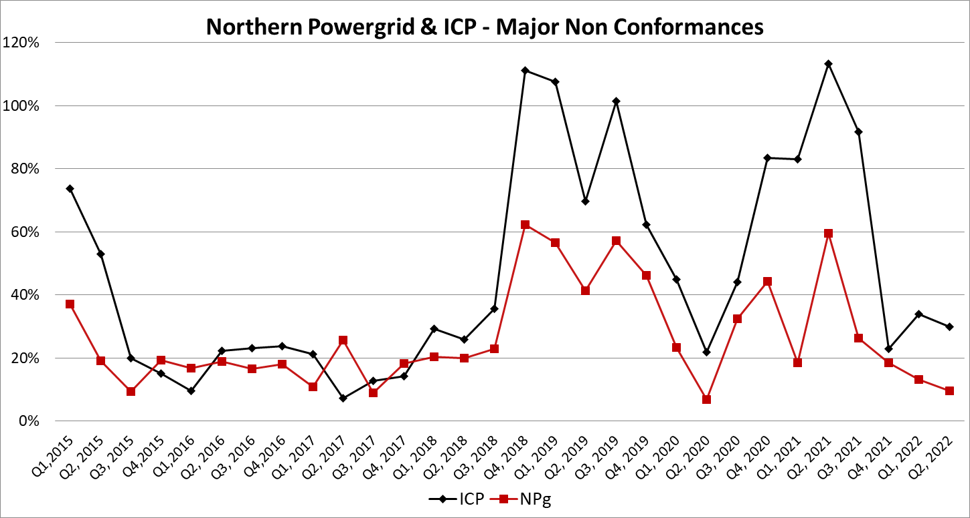
Major Non-Conformance Trends

Slide 47
ICP Major NC Trend
Average 2020 – 49%
Average 2021 – 78%
Average YTD 2022 – 30%
Significant reduction on 2021

Slide 48
Major and Minor NC’s
Major non-conformances raised include:
• Sites with shallow or over depth cables or ducts (with no mitigation)
• Sites where tile tape was missing over energised cables
• Incorrect tile tape on NPg/IDNO cables
• Sites where cables had not been sanded
• Site where line and levels could not be confirmed
Minor non-conformances raised include:
• Minor tile tape installation issues.
• Minor deviation of cable route from approved drawing.
• Sites where rectification issues were carried out at time of visit.
• Sites where no shorting caps fitted

Slide 49
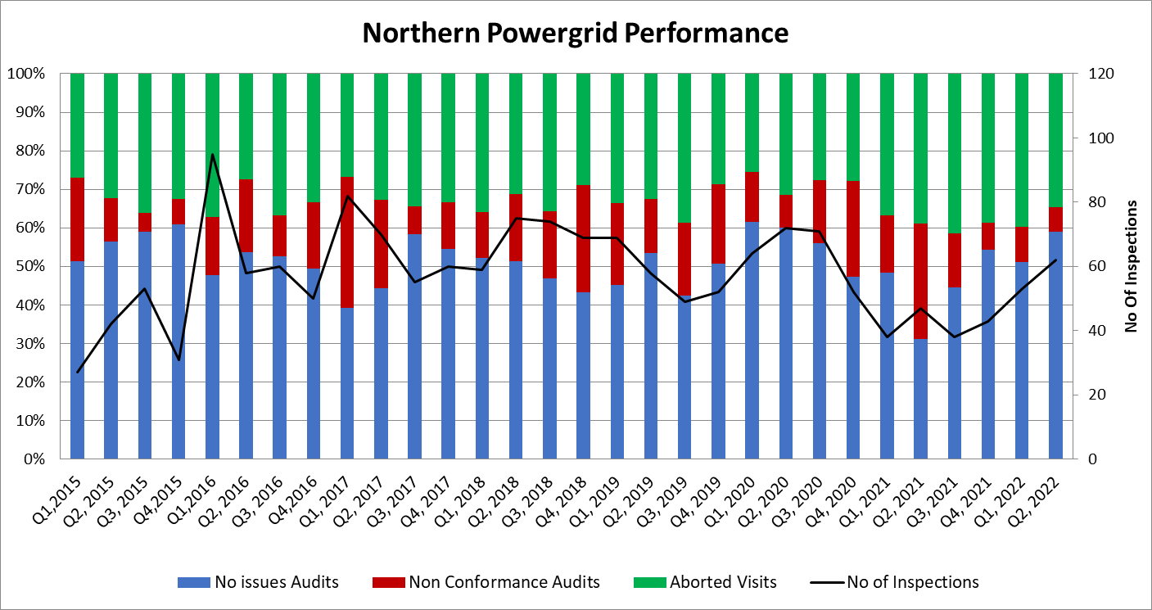
Analysis of Performance

Slide 50
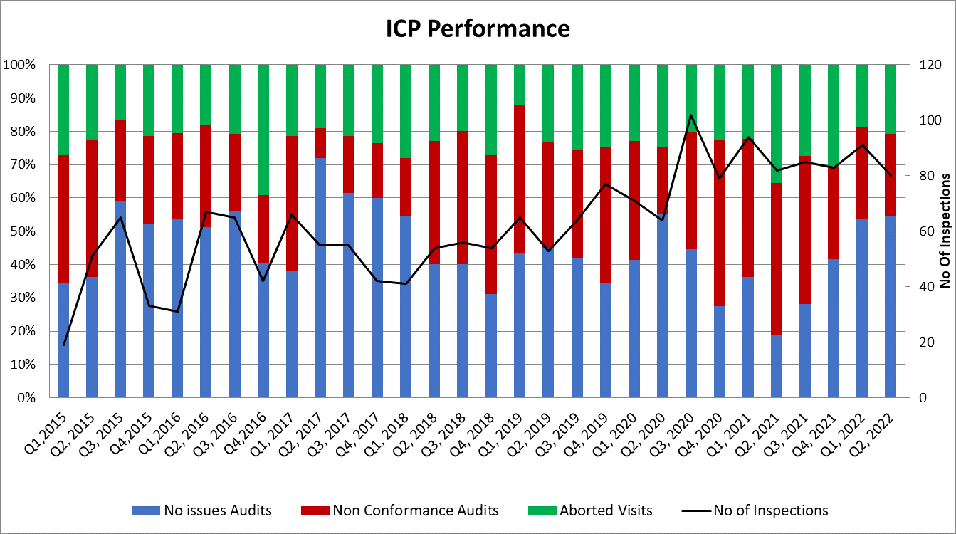
Analysis of Performance

Slide 51
Abortive visits & whereabouts
Combined average 2020 – 25%
Combined average 2021 – 33%
Combined average YTD 2022 – 28%
Update Whereabouts sheets or pick up the phone
07973 946581
Missing whereabouts – cables installed without the opportunity to inspect

Slide 52
Thank you

Slide 53
Group Discussion and Q&A
Timeframes and Lead Times

Slide 54
Lunch and networking
12.10-13.00

Slide 55
Drop-in Sessions
- CT Metering and Commissioning
- Delivery and Call Off Process
- One Identity Login

Slide 56
Group Discussion and Q&A

Slide 57
Final thoughts
Phil Jagger
System Design Manager

Slide 58
Thank you for your time and participation today.

